Slide 1


Slide 2


Drawn controls in .NET MAUI
Javier Suárez Ruiz
@jsuarezruiz

Slide 3
.NET MAUI Summary
SDK-style projects
Single-headed project
CLI support
.NET 6 BCL
Multi-paradigm
XAML markup & C# UI supported
DESKTOP
MOBILE
.NET MAUI
Windows
iOS
File | New
Multi-platform App UI (.NET)
CLI
dotnet install maui
dotnet new maui
Namespaces
Microsoft.Maui (previously Xamarin.Forms)
Microsoft.Device (previously Xamarin.Essentials)
macOS
Android
Compatibility
Minimal API Changes – All add developer value (perf, dev loop, etc.)
Migration support for Xamarin & Xamarin.Forms
Existing Xamarin.Forms app support for one-year window after release of .NET MAUI

Slide 4

Experimental
drawn controls

Slide 5

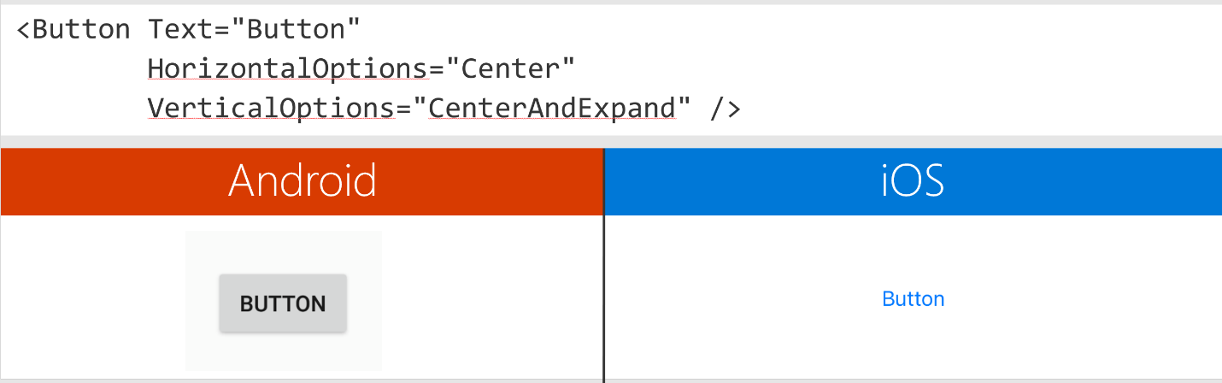
Feedback received
Consistent look and behavior.
Easy way to extend and customize.
The Visual Material implementation is consistent, but rigid in its prescriptive design which doesn’t match some customer designs.

Slide 6

Microsoft.Maui.Graphics
Microsoft.Maui.Graphics is a cross-platform graphics library for iOS, Android, Windows, macOS, Tizen and Linux completely in C#. With this library you can use a common API to target multiple abstractions allowing you to share your drawing code between platforms, or mix and match graphics implentations within a singular application.

Slide 7
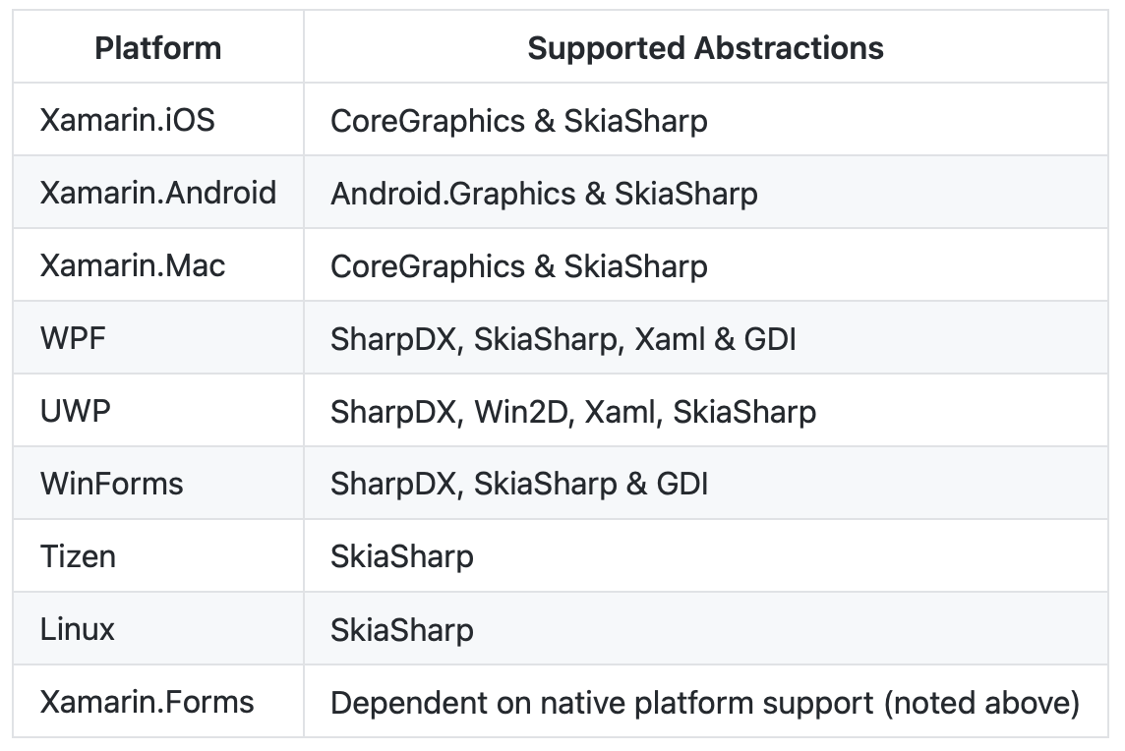
Microsoft.Maui.Graphics: Supported platforms

Slide 8
Demo
Microsoft.Maui.Graphics

Slide 9
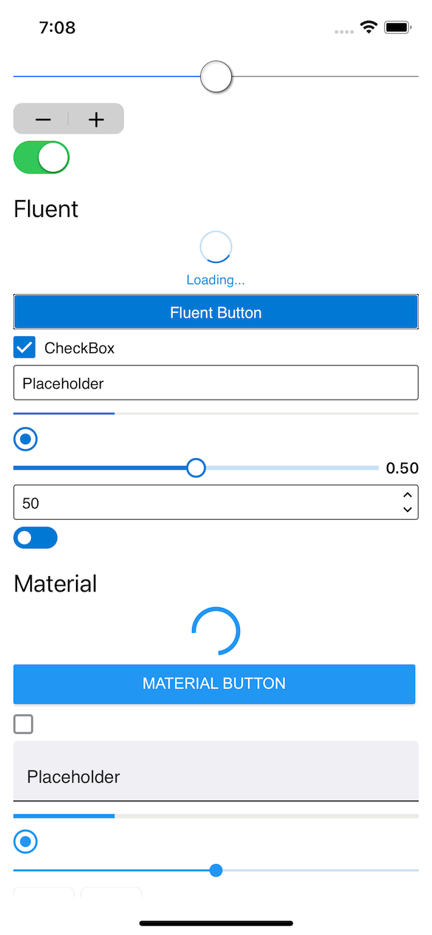
Microsoft.Maui.Graphics.Controls
Microsoft.Maui.Graphics.Controls (GraphicsControls) is a library that offers the controls available in Xamarin.Forms Visual allowing to choose between Cupertino, Fluent and Material but, instead of creating native controls, are drawn controls.
This project is a .NET experiment related to .NET MAUI with different tests to validate the interest and feasibility of drawn controls but is not covered by Microsoft support (yet).

Slide 10
Microsoft.Maui.Graphics.Controls
Available controls:
ActivityIndicator (Cupertino, Fluent, Material)
Button (Cupertino, Fluent, Material)
CheckBox (Cupertino, Fluent, Material)
DatePicker (Cupertino, Fluent, Material)
Editor (Cupertino, Fluent, Material)
Entry (Cupertino, Fluent, Material)
ProgressBar (Cupertino, Fluent, Material)
RadioButton (Cupertino, Fluent, Material)
Slider (Cupertino, Fluent, Material)
Stepper (Cupertino, Fluent, Material)
Switch (Cupertino, Fluent, Material)
TimePicker (Cupertino, Fluent, Material)

Slide 11
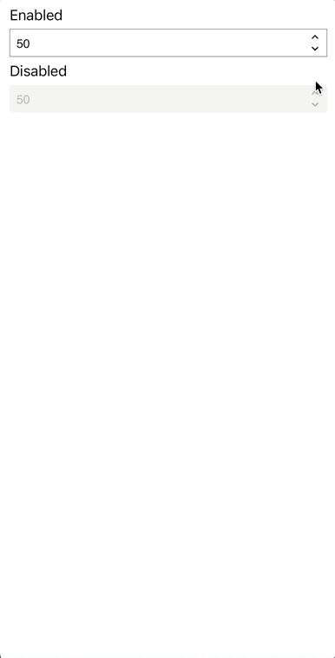
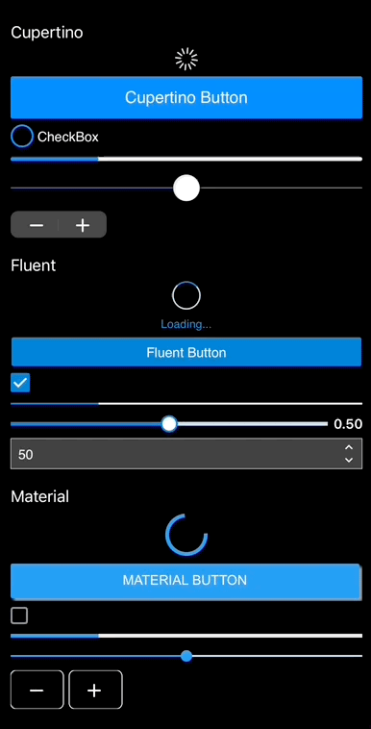
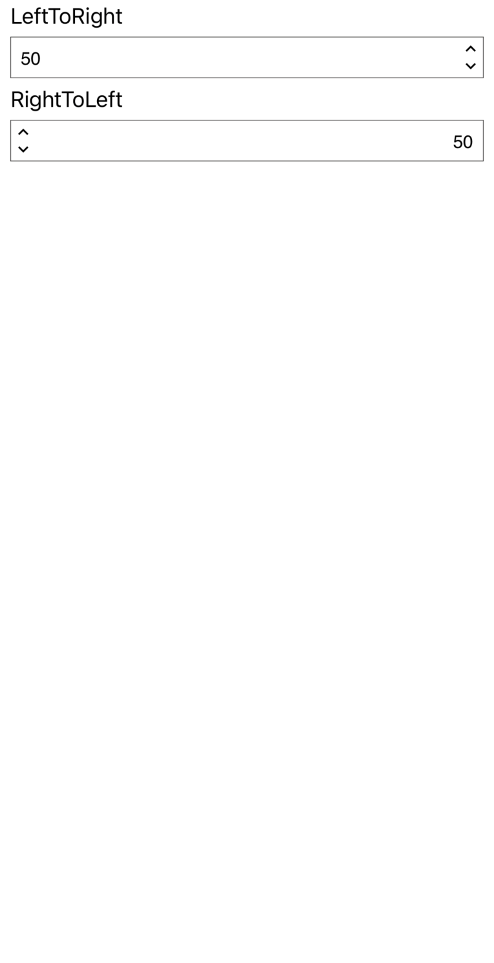
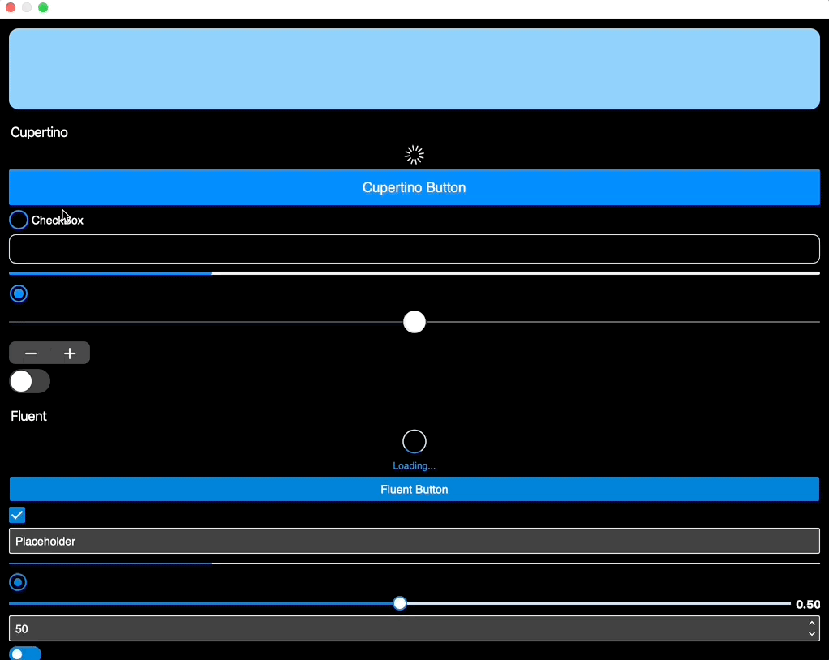
Microsoft.Maui.Graphics.Controls
Features:
Pixel perfect drawn and same behavior in all the platforms.
RTL support.
Accesibility support.
Themes support.
Phone and Desktop support.

Slide 12
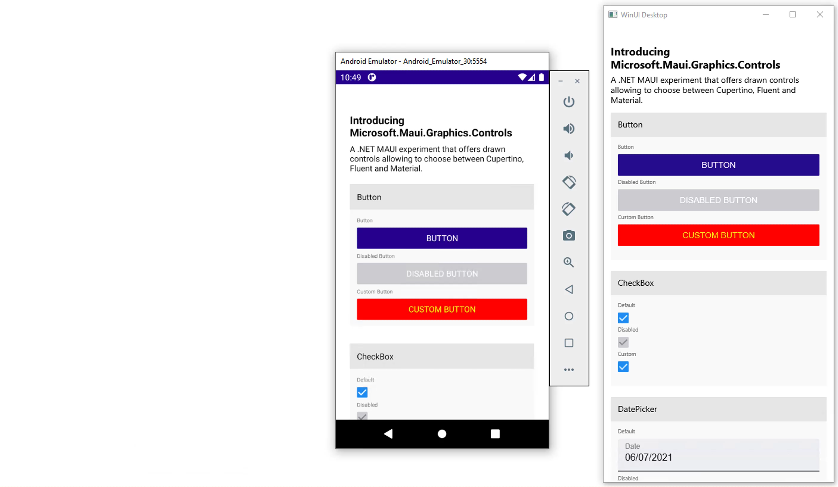
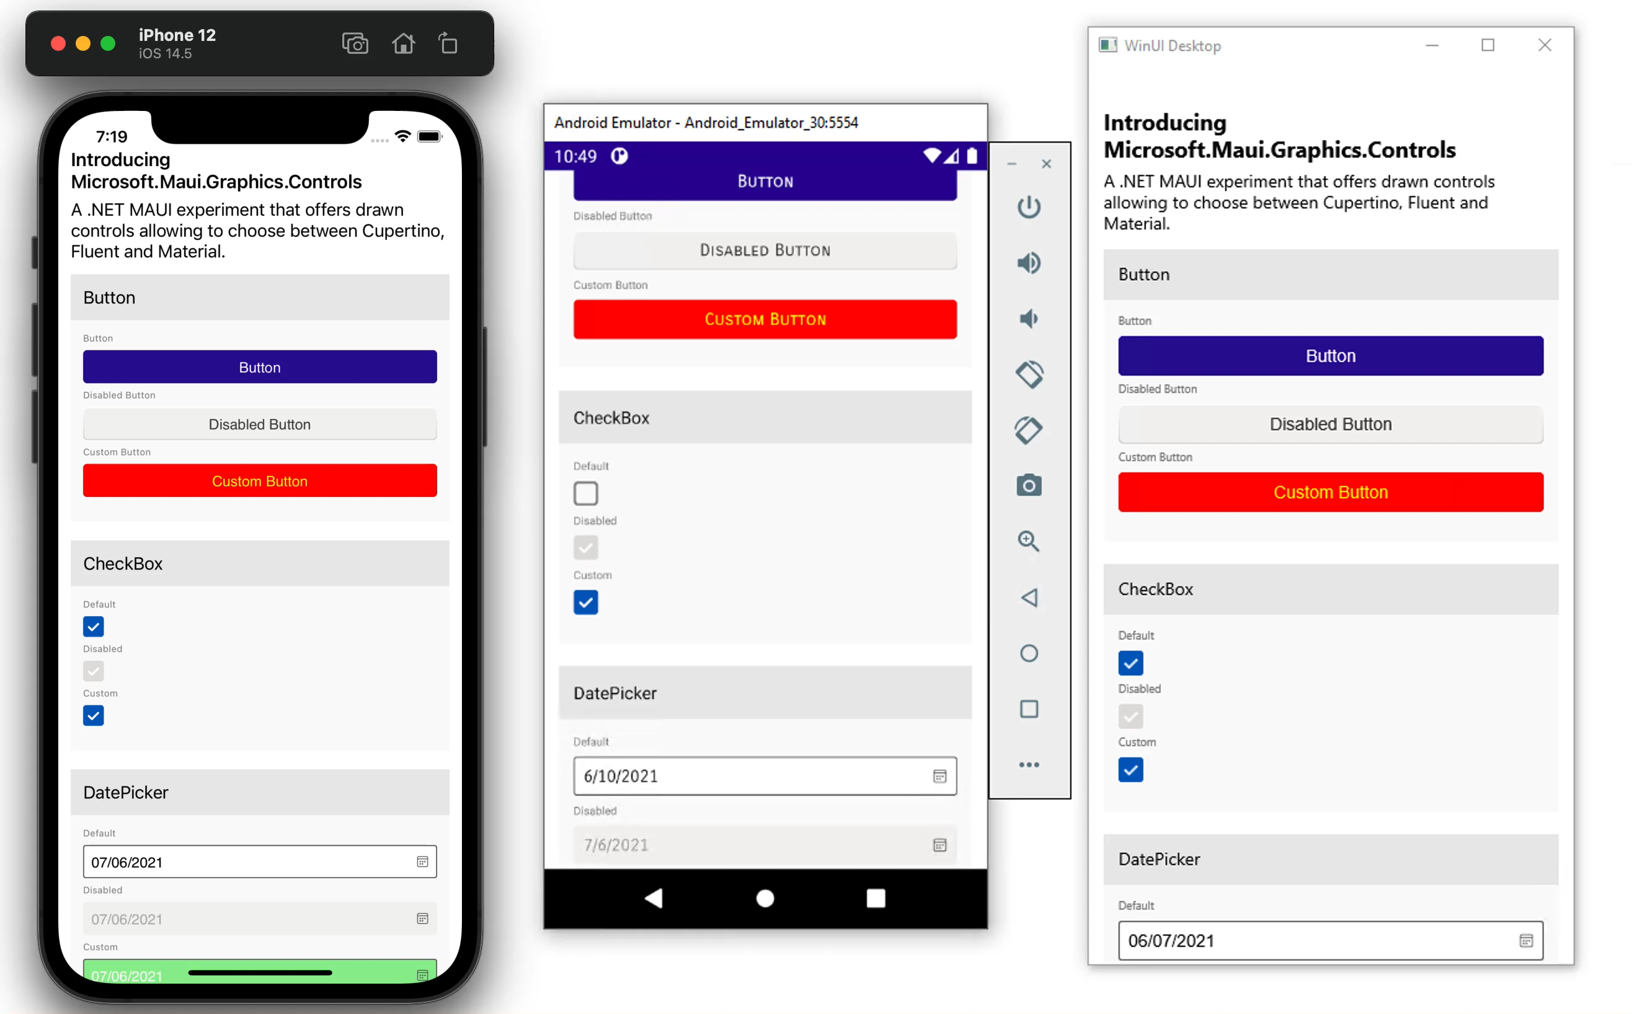
Microsoft.Maui.Graphics.Controls
Features:
Cupertino, Fluent and Material design.
Material
Fluent

Slide 13
Demo
Microsoft.Maui.Graphics.Controls

Slide 14

Customize
drawn controls

Slide 15
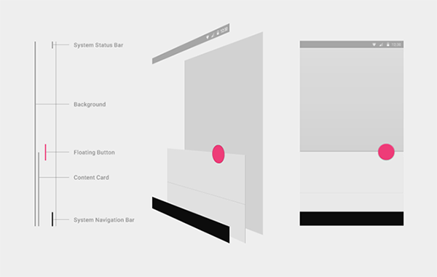
Extend graphics controls
All drawn controls are created by layers. It is possible to access each layer, in addition to customizing a specific layer or adding/removing layers.
As in .NET MAUI, drawn controls use Handlers and a DrawMapper with information about each layer.

Slide 16
Extend a drawn control
The easiest way to extend an existing drawn control is to simply override its Draw method to draw any extra content.
public class CustomSliderHandler : SliderHandler
{
protected override ISliderDrawable CreateDrawable() => new MaterialSliderDrawable();
public override void Draw(ICanvas canvas, RectangleF dirtyRect)
{
base.Draw(canvas, dirtyRect);
// Your own content
}
}

Slide 17
Extend a drawn control
Customize how to draw a specific layer.
DrawMapper[nameof(ISliderDrawable.DrawThumb)] = (canvas, rect, drawable, slider) =>
{
}
Also can override all the parts from a control.

Slide 18
Demo
Customize drawn controls

Slide 19
Summary
Microsoft.Maui.Graphics.Controls is an experimental library that offers the controls available in Xamarin.Forms Visual allowing to choose between Cupertino, Fluent and Material but, instead of creating native controls, are drawn controls.
Already implemented Visual controls with theme, RTL and accesibility support.
Could be part of .NET MAUI in the future, at the moment, we collect feedback.
Already available NuGet package: https://aka.ms/maui-graphics-controls-nightly/index.json

Slide 20

Questions?

Slide 21

Thanks for joining!

